Slide 1
PART 5:
CONTROLLING : Quality and Performance

Slide 2
Controlling
Managers use a variety of measures to monitor performance:
Controlling work processes
Regulating employee behavior
Systems for financial resources
Evaluating profitability

Slide 3
The Meaning of Control
Organizational control is the systematic process through which managers regulate organizational activities to make them consistent with expectations established in plans, targets, and standards of performance

Slide 4
Choosing Standards and Measures
Common measures and controls:
Sales
Revenue
Profit
More focus on measuring intangibles
Customer service
Increased revenue

Slide 5
Steps of Feedback Control
Establish Standards of Performance
Measure Actual Performance
Compare Performance to Standards
Take Corrective Action

Slide 6
Application to Budgeting
Budgetary control – setting targets and monitoring expenditures
Budgets list planned and actual expenditures
Budgets are associated with a division or department
The unit of analysis for budgeting is the responsibility center

Slide 7
Financial Control
Financial Statements provide basic information for financial control
Balance Sheet shows firm’s financial position
Income Statement profit-and-loss statement or P&L highlights firm’s financial performance

Slide 8
Hierarchical versus Decentralized Approaches
Hierarchical controls include the monitoring of behavior through rules, policies, reward systems, and written documentation
Decentralized controls based on values and assumptions; rules are only used when necessary
Culture is adaptive, uniting individuals and teams
Managers’ approach to control is changing in many of today’s organizations

Slide 9
Open-Book Management
Decentralized philosophy
Get every employee thinking like an owner
Information sharing and teamwork
Allows employees to see the financial condition of company
See how his/her job fits into organizational success

Slide 10
Total Quality Management (TQM)
Infuse quality into every aspect of the business, all day-to-day activities
Focuses on:
Teamwork
Collaboration
Identifying improvements

Slide 11
TQM
Total - made up of the whole
Quality - degree of excellence a product or service provides
Management - act, art or manner of planning, controlling, directing,….
Therefore, TQM is the art of managing the whole to achieve excellence.
Total Quality Management

Slide 12
What’s the goal of TQM?
“Do the right things right the first time, every time.” –zero defect

Slide 13
Another way to put it
At it’s simplest, TQM is all managers leading and facilitating all contributors in everyone’s two main objectives:
(1) total client satisfaction through quality products and services; and
(2) continuous improvements to processes, systems, people, suppliers, partners, products, and services.

Slide 14
The three aspects of TQM
Tools, techniques, and training in their use for analyzing, understanding, and solving quality problems
Counting
Customers
Culture
Quality for the customer as a
driving force and central concern.
Shared values and beliefs, expressed by leaders, that define and support quality.

Slide 15
Value-based Approach
Manufacturing Dimensions
Performance
Features
Reliability
Conformance
Durability
Serviceability
Perceived quality
Service Dimensions
Reliability
Responsiveness
Assurance
Empathy

Slide 16
The TQM System
Objective
Continuous
Improvement
Principles
Customer
Focus
Process
Improvement
Total
Involvement
Leadership
Education and Training Supportive structure
Communications Reward and recognition
Measurement
Elements

Slide 17
International Quality Standards
ISO 9000 standards – International Organization for Standardization
Organization certification
157 Countries
Organizations demonstrate a commitment to quality
Europe leads in certifications but the United States has had large increases

Slide 18
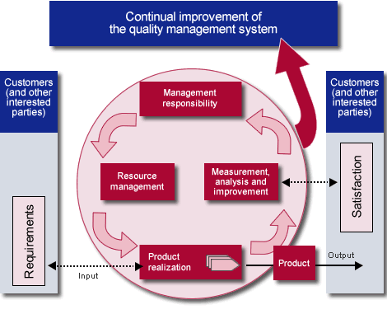
ISO 9001: 2000 QMS Model

Slide 19
Control of Human Behavior : A HRM revisit
Have rules & regulations
Fair reward system
Training
Performance appraisal
Disciplinary procedures

Slide 20
Thank you

