Slide 1
Chap 3: Model Diagnostic Checking
Ani Shabri
Department of Mathematical Sciences,
Faculty of Science, Universiti Teknologi Malaysia,
81310 UTM Johor Bahru, Malaysia
ani@utm.my
Jun 8, 2014

Slide 2
Chap 3: Model Diagnostic Checking
Outline:
Introduction to diagnostics checking
Model adequacy checking
Testing for zero mean
Testing for constant variances
Testing independent of error
Normality tests
Evaluating the accuracy of the model

Slide 3
Introduction to diagnostics checking
It is important to check the adequacy of the model before it used in forecasting and becomes part of the decision making process.
It is important to study outlying observations to decide whether they should be retained or eliminated.
If retained, whether their influence should be reduced in the fitting process or revise the regression function.
Residual plots can be used to check the model assumptions.

Slide 4
Model adequacy checking
The Time Series model is adequate if the error of the model meet 4 assumptions (error = )
1. The error component will have zero mean ;
2. The variance of , denoted by σ ², is the same for all values of the independent variable(s), i.e.,
3. The errors are independent.
4. The errors has a normal distribution with mean zero and variance constants.

Slide 5
Testing for zero mean
Hypothesis
Statistics Test
For n < 30
For n > 29
Reject
Reject

Slide 6
Testing for constant variances
Residuals are often standardized so that they have mean zero and variance one. Since residuals are estimates of the errors, and since the observed errors have variance , the standardized residuals are given by
where
p = the number of parameters model.
The variance of errors is constant if are within or almost all of them should be within and should exhibit the random pattern

Slide 7
Pattern of forecast error
Standard Error
Standard Error
0
0
T
T
Random errors
Cyclical effects not accounted for
Standard Error
Standard Error
0
0
T
T
Trend not full accounted for
Seasonal effects not accounted for

Slide 8
Testing independent of error
Autocorrelation function (ACF) of errors is used to
check independent of error. ACF of errors is given by
The errors are independents if all (of most) of the ACF are within

Slide 9
Normality tests
In statistics, the Jarque–Bera (JB) test is one procedure for determining whether sample data (errors) are normal distribution. The test is named after Carlos Jarque and Anil K. Bera. The test statistic JB is defined as
where n is the number of observations (or degrees of freedom in general); S is the sample skewness, and K is the sample kurtosis:
The data does not follows normal distribution if JB

Slide 10
Anderson–Darling test
In statistics, the Anderson–Darling (AD) test is usually used to test whether the data (errors) follows normal distribution. The AD test is given by
For normal distribution, the formula is
A modified statistic is calculated using
Φ is standard normal CDF
and normality is rejected if A ^{* 2} exceeds 0.631, 0.752, 0.873, 1.035, or 1.159 at 10%, 5%, 2.5%, 1%, and 0.5% significance levels, respectively; the procedure is valid for sample size at least n=8.

Slide 11
Evaluating the accuracy of the model
If the null hypothesis of the validating model assumptions
are rejected, then we might look several common causes:
The wrong model was chosen (e.g. linear regression model used with non-linear data)
There are other components in the time series (e.g. cycle or seasonal components that have not been modeled).
The equation has not completely modeled the trend (i.e., there is trend left in the error)
If error is large, either model being used is the wrong one, or parameters need adjusting.

Slide 12
Example
The following table gives the average cost (in cents per kilo watt hour) of electricity from 1995 to 2008.
Year | Rate
1995 | 4.5
1996 | 4.7
1997 | 5.1
1998 | 5.3
1999 | 5.6
2000 | 6.4
2001 | 7.2
2002 | 7.9
2003 | 8.2
2004 | 8.5
2005 | 8.8
2006 | 8.4
2007 | 8.4
2008 | 8.5

Slide 13
Example
The scatter plot suggests that a linear regression model is appropriate.
Least squares method was used to fit a regression line to the data
Linear regression model Y = 4.2033 + 0.3681 t
 | Coefficients | Standard Error | t Stat | P-value
Intercept | 4.2033 | 0.3032 | 13.8642 | 9.53E-09
X Variable 1 | 0.3681 | 0.0356 | 10.3389 | 2.5E-07

Slide 14
Example
Testing the Mean of Error is Zero
Hypothesis
Statistics Test
For n < 30
Since
Accept
Conclusion: The mean of Errors is Zero

Slide 15
Example
The standard residuals were plotted against the fitted values.
The plot shows that the residuals are not consistent and exists a seasonal effects.

Slide 16
Example
To confirm this graphic diagnosis we will use the Autocorrelation function (ACF) of errors test for:
Errors are independents
Errors are dependents
The test statistic is:
The errors are independents if all (of most) of the ACF are within

Slide 17
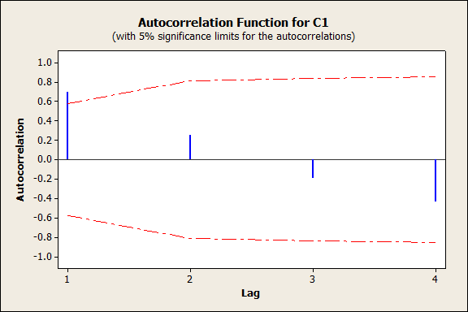
Example
The Figure shows that the errors are dependent due to one of the ACF (ACF at t=1) is outside

Slide 18
Example
The Figure and p-value of AD test shows that
the errors are follow normal distribution.

Slide 19
Example
Conclusion
The study shows that only 2 the criterion for assumption were satisfied (mean of errors is zero and the errors follows normal distribution).
We can make conclusion that the linear regression might be inappropriate and it would be more appropriate to use non-linear regression model.

